Slide 1
LTL Generator Demo

Slide 2
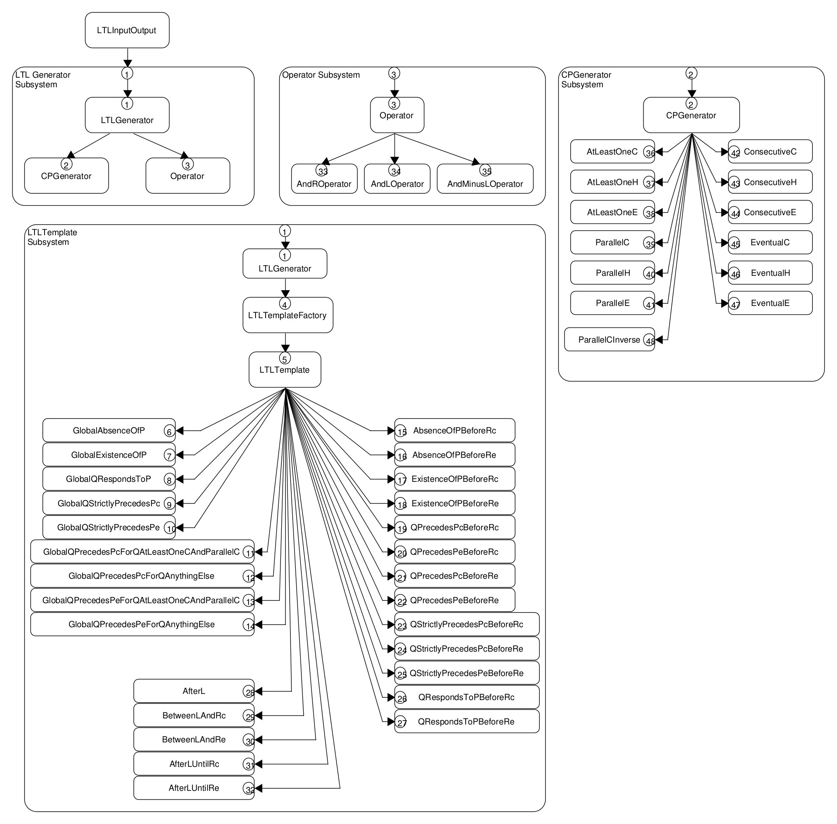

Slide 3
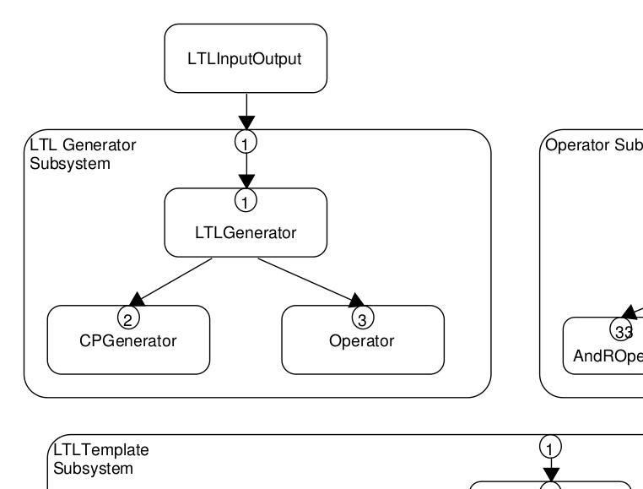

Slide 4
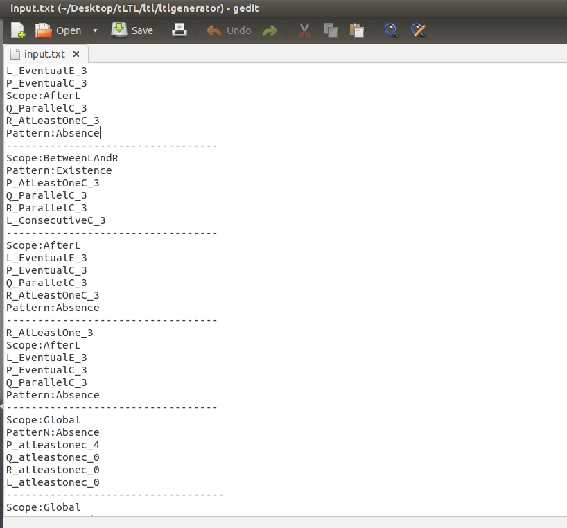
input
ex:

Slide 5
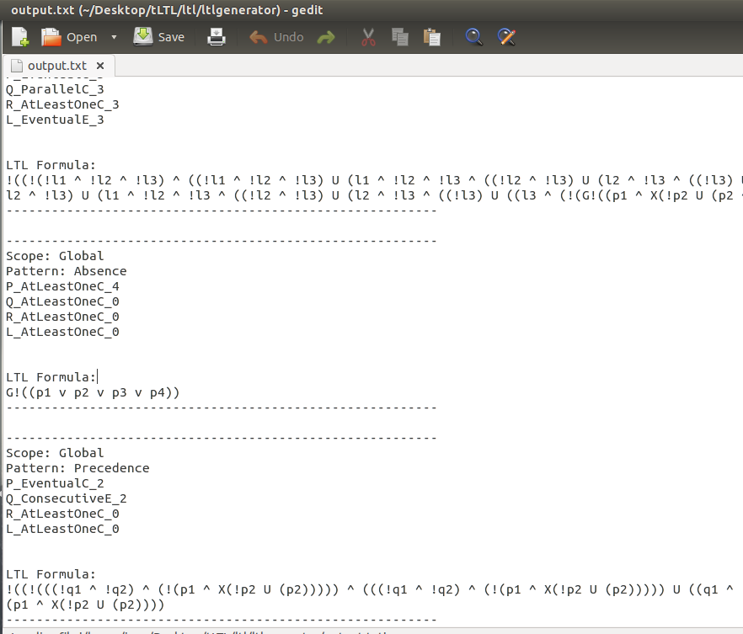
output
ex:

Slide 6
Live Demo

Slide 7
Examples of output
OUTPUT
---------------------------------------------------------
Scope: AfterL
Pattern: Absence
P_EventualC_3
Q_ParallelC_3
R_AtLeastOneC_3
L_EventualE_3
LTL Formula:
!((!(!l1 ^ !l2 ^ !l3) ^ ((!l1 ^ !l2 ^ !l3) U (l1 ^ !l2 ^ !l3 ^ ((!l2 ^ !l3) U (l2 ^ !l3 ^ ((!l3) U (l3))))))) U ((!l1 ^ !l2 ^ !l3) ^ ((!l1 ^ !l2 ^ !l3) U (l1 ^ !l2 ^ !l3 ^ ((!l2 ^ !l3) U (l2 ^ !l3 ^ ((!l3) U ((l3 ^ (!(G!((p1 ^ X(!p2 U (p2 ^ X(!p3 U (p3)))))))))))))))))
---------------------------------------------------------
INPUT
Scope:AfterL
Pattern:Absence
L_EventualE_3
P_EventualC_3
Q_ParallelC_3
R_AtLeastOneC_3

Slide 8
Example cont.
QRespondsPBetweenLandR
L_AtLeastOneC
P_AtLeastOneE
Q_ParallelC
R_ConsecutiveC
------------------
G(((l1 | l2 | l3) & (!(((r1) & X((r2) & X(r3)))))) -> ((l1 | l2 | l3) & (!(!(((r1) & X((r2) & X(r3)))) U (((((!p1 & !p2 & !p3) & (!(((r1) & X((r2) & X(r3)))))) & (((!p1 & !p2 & !p3) & (!(((r1) & X((r2) & X(r3)))))) U (((p1 | p2 | p3) & (!(((q1 & q2 & q3) & (!(((r1) & X((r2) & X(r3))))))) U (((r1) & X((r2) & X(r3))))) & (!(((r1) & X((r2) & X(r3)))))))))))))))
G((((l1 v l2 v l3) ^ (!(r1 ^ X(r2 ^ X(r3)))))) -> (((l1 v l2 v l3) ^ (!((!(r1 ^ X(r2 ^ X(r3)))) U (((!p1 ^ !p2 ^ !p3) ^ (!(r1 ^ X(r2 ^ X(r3))))) ^ (((!p1 ^ !p2 ^ !p3) ^ (!(r1 ^ X(r2 ^ X(r3))))) U ((p1 v p2 v p3) ^ (!(r1 ^ X(r2 ^ X(r3) ^ (((!(((q1 ^ q2 ^ q3) ^ (!(r1 ^ X(r2 ^ X(r3))))))) U (r1 ^ X(r2 ^ X(r3))))))))))))))))
Given example
Actual result

